Slide 1
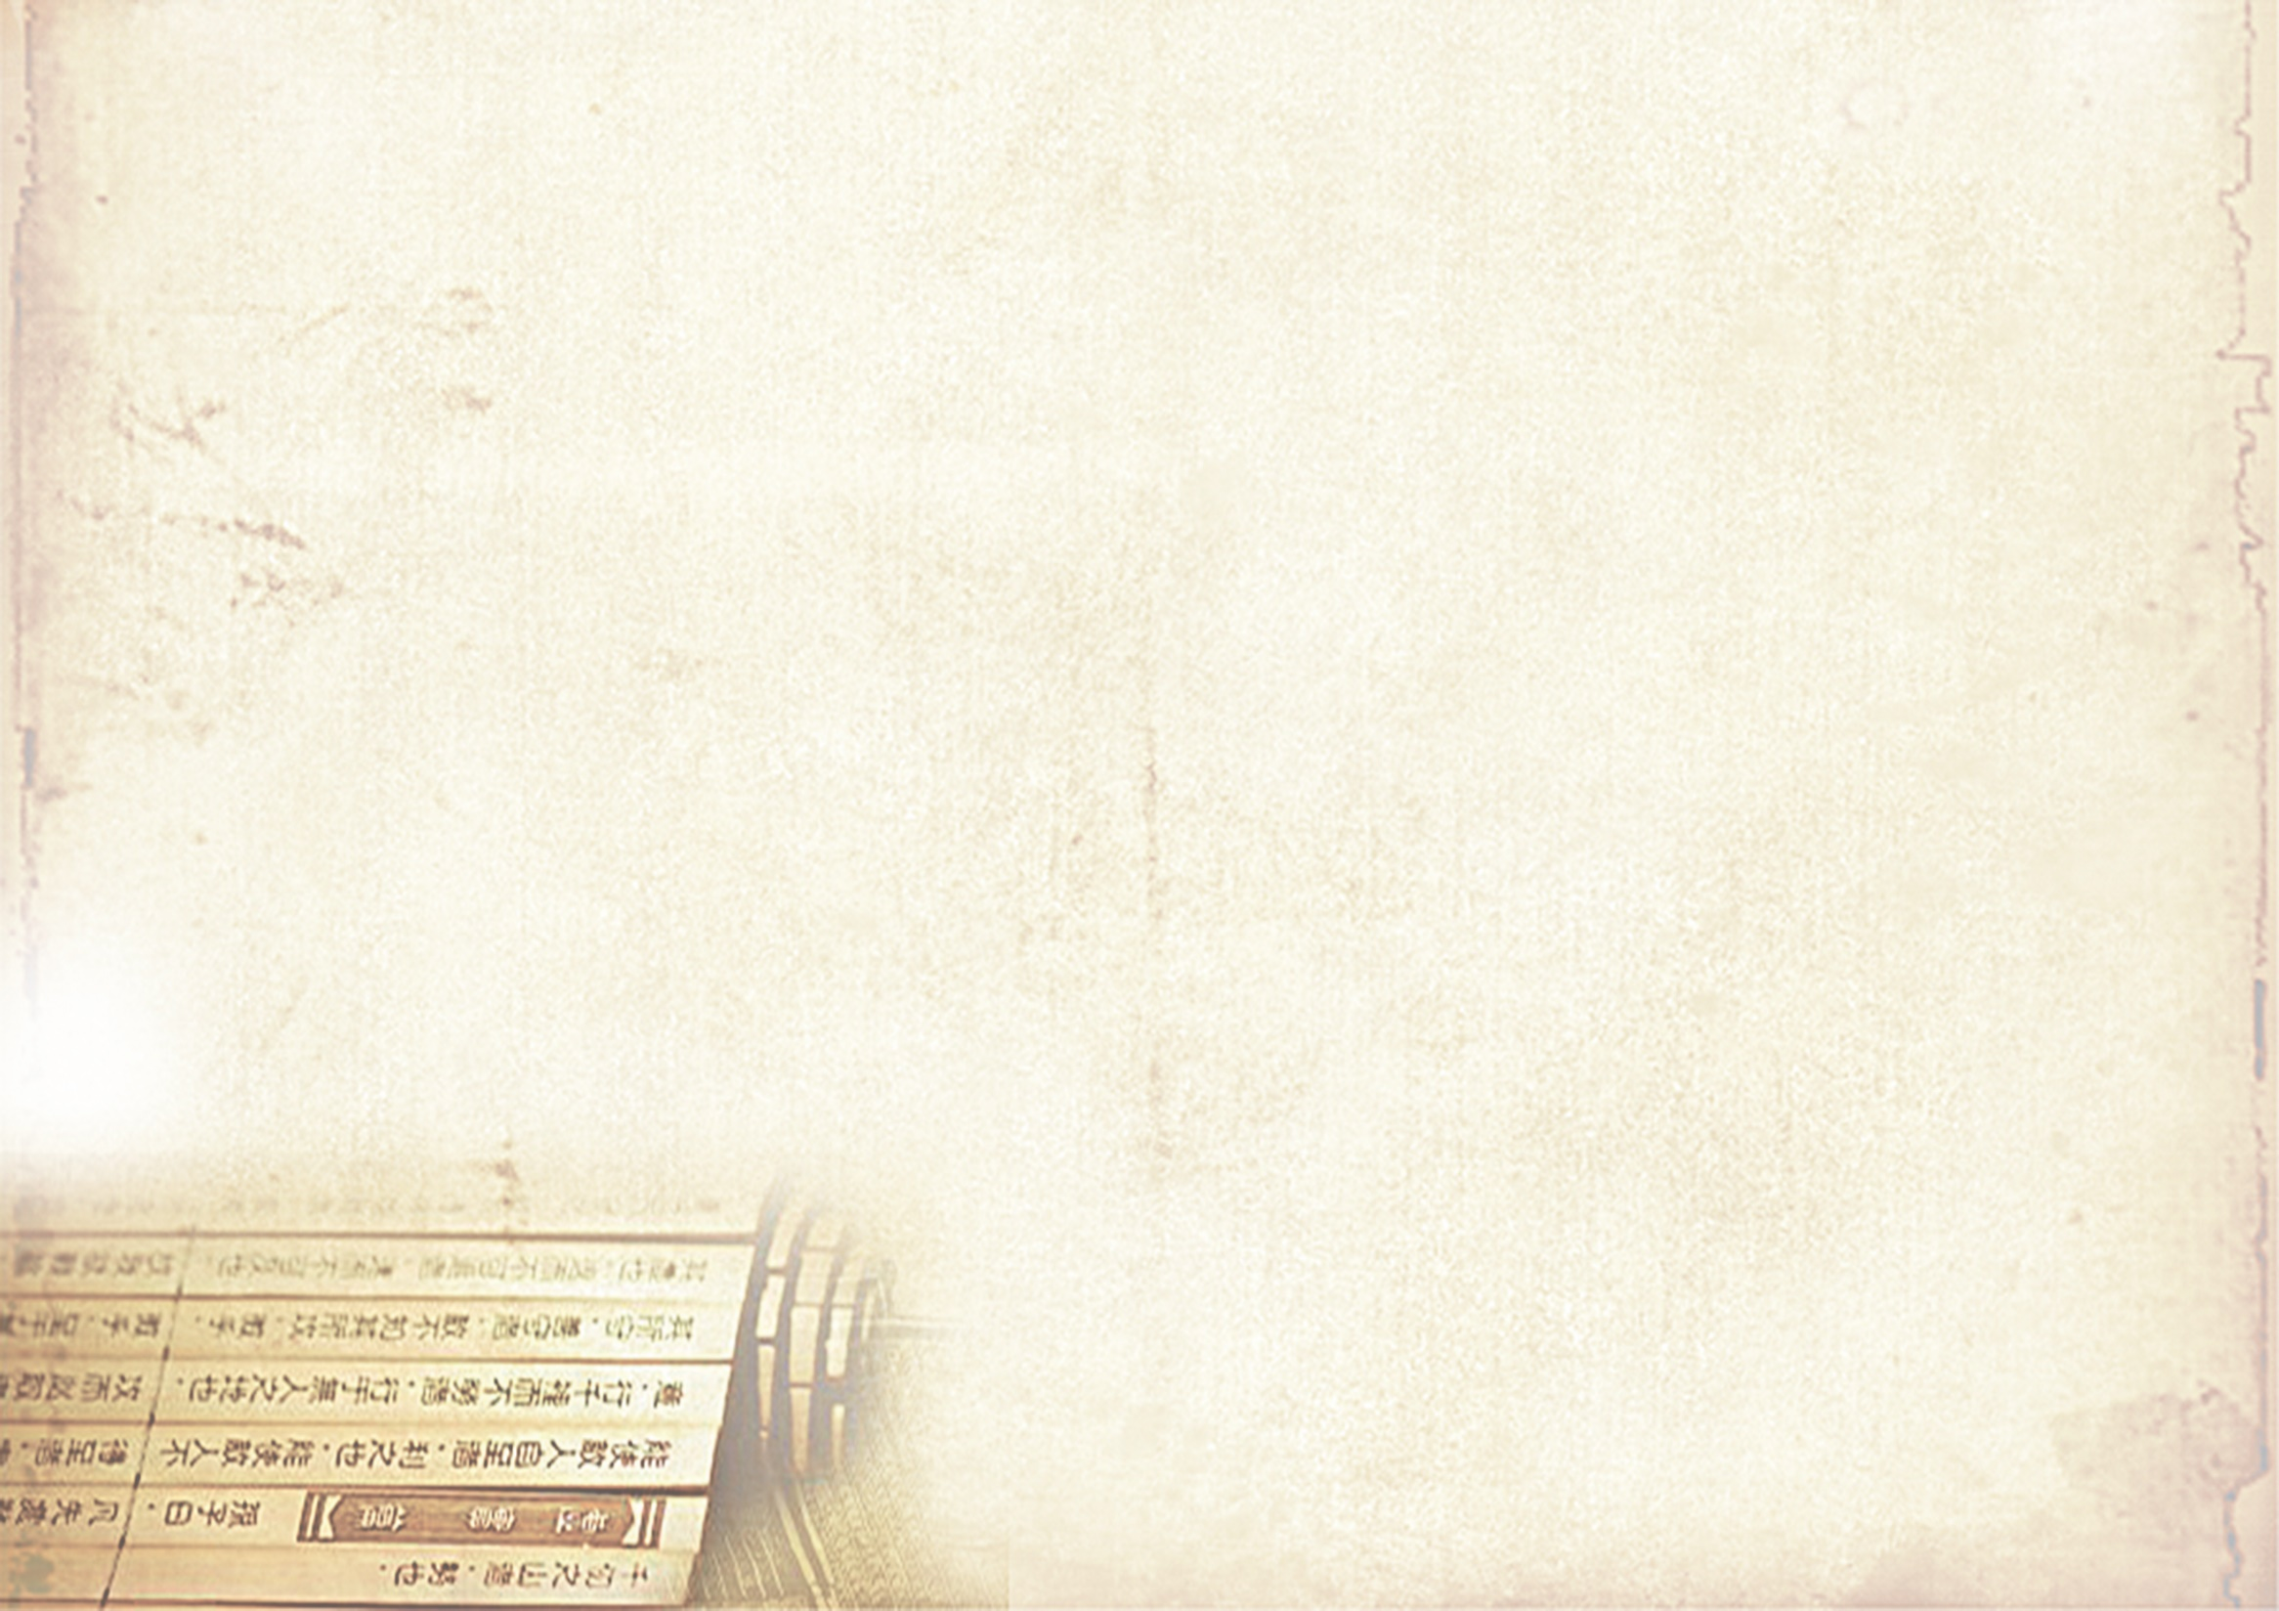
Whom We Treat
Anyone, including pregnant women and children (age at 0 – 17), who are willing to have a TCM treatment to promote natural healing.
What We Treat
We offer individualized treatment plan and Lifestyle changing advice tailor made for the individuals.
We provide systematic treatment to promote natural healing in the following areas:
Short term relief of stress, anxiety.
Short term relief of acute and chronic Pain including headaches, migraine, muscle tension, and etc.
Short term relief of menstrual irregularities, infertility.
Short term relief of low energy, fatigue.
Short term relief of nausea, constipation, diarrhoea, IBS.
Short term relief of asthma, hay fever, fibromyalgia, arthritis, renal disease, skin problems, and etc.
For more information, pleaser visit:
http://www.acupuncture.org.uk/category/a-to-z-of-conditions/a-to-z-of-conditions.html
What We Do
ACUPUNCTURE
Acupuncture is a form of therapy in which insertion of sterile, disposable, stainless steel fine needles applies on the acupuncture points of the body, to promote the flow of Qi (or vital energy), thereby restoring and maintaining health. Acupuncture is widely accepted and used globally.
TCM acupuncture treatment is aimed at the underlying root conditions causing the main symptoms. Therefore, this approach provides significant health benefits, by not only addressing specific conditions, but also developing general health and wellbeing.
TUINA – THERAPEUTIC MASSAGE INCLUDED PAEDIATRIC MASSAGE
TUINA is a widely used treatment method for both relaxation and therapy. Paediatric massage is well accepted and commonly used for infants, toddlers and young children. Paediatric massage therapy is suitable for children aged under 12.
OTHER TREATMENTS
Electro-acupuncture, Cupping, Guasha (Scrapping), Moxa, Ear seeds therapies are also available.
Traditional Chinese Medicine (TCM)
TCM has existed over 2000 years. It is a comprehensive medical system based on its own philosophy, with traditional diagnosis and therapeutic methods.
There are three basic components in TCM:
Chinese Herbal Remedies
Acupuncture
Tuina (Therapeutic massage)
Chinese Medicine theory believes human being are children of nature. The spirit of Traditional Chinese Medicine (TCM) is to achieve the harmonisation of human and nature. TCM treatment is a natural therapeutic method to maintain the body’s equilibrium, promote body healing and improve functions systematically. TCM can be an effective therapy to restore body balance and promote both physical and mental harmony.

